Slide 1
HOW TO INSTALL CANVA?
BAHASA INGGRIS
presented by group 4 ☺

Slide 2
Names of group members :
Tyara Kusuma Nevada (2341720019)
Dandi Azrul Syahputra (2341720118)
Tionusa Catur Pamungkas (2341720093)

Slide 3
TOPICS TO DISCUSS:
What is Canva
How to install Canva on Windows
How to use Canva on Windows
How to install Canva on Android
How to use Canva on Android

Slide 4

What is canva??
Canva is a graphic design application used to create social media graphics, presentations, posters, documents and other visual content. This application also provides various design examples to use, this application also consists of free and paid services.
Source: https://www.canva.com/id_id/help/

Slide 5
How to Install Canva on Windows
BAHASA INGGRIS

Slide 6
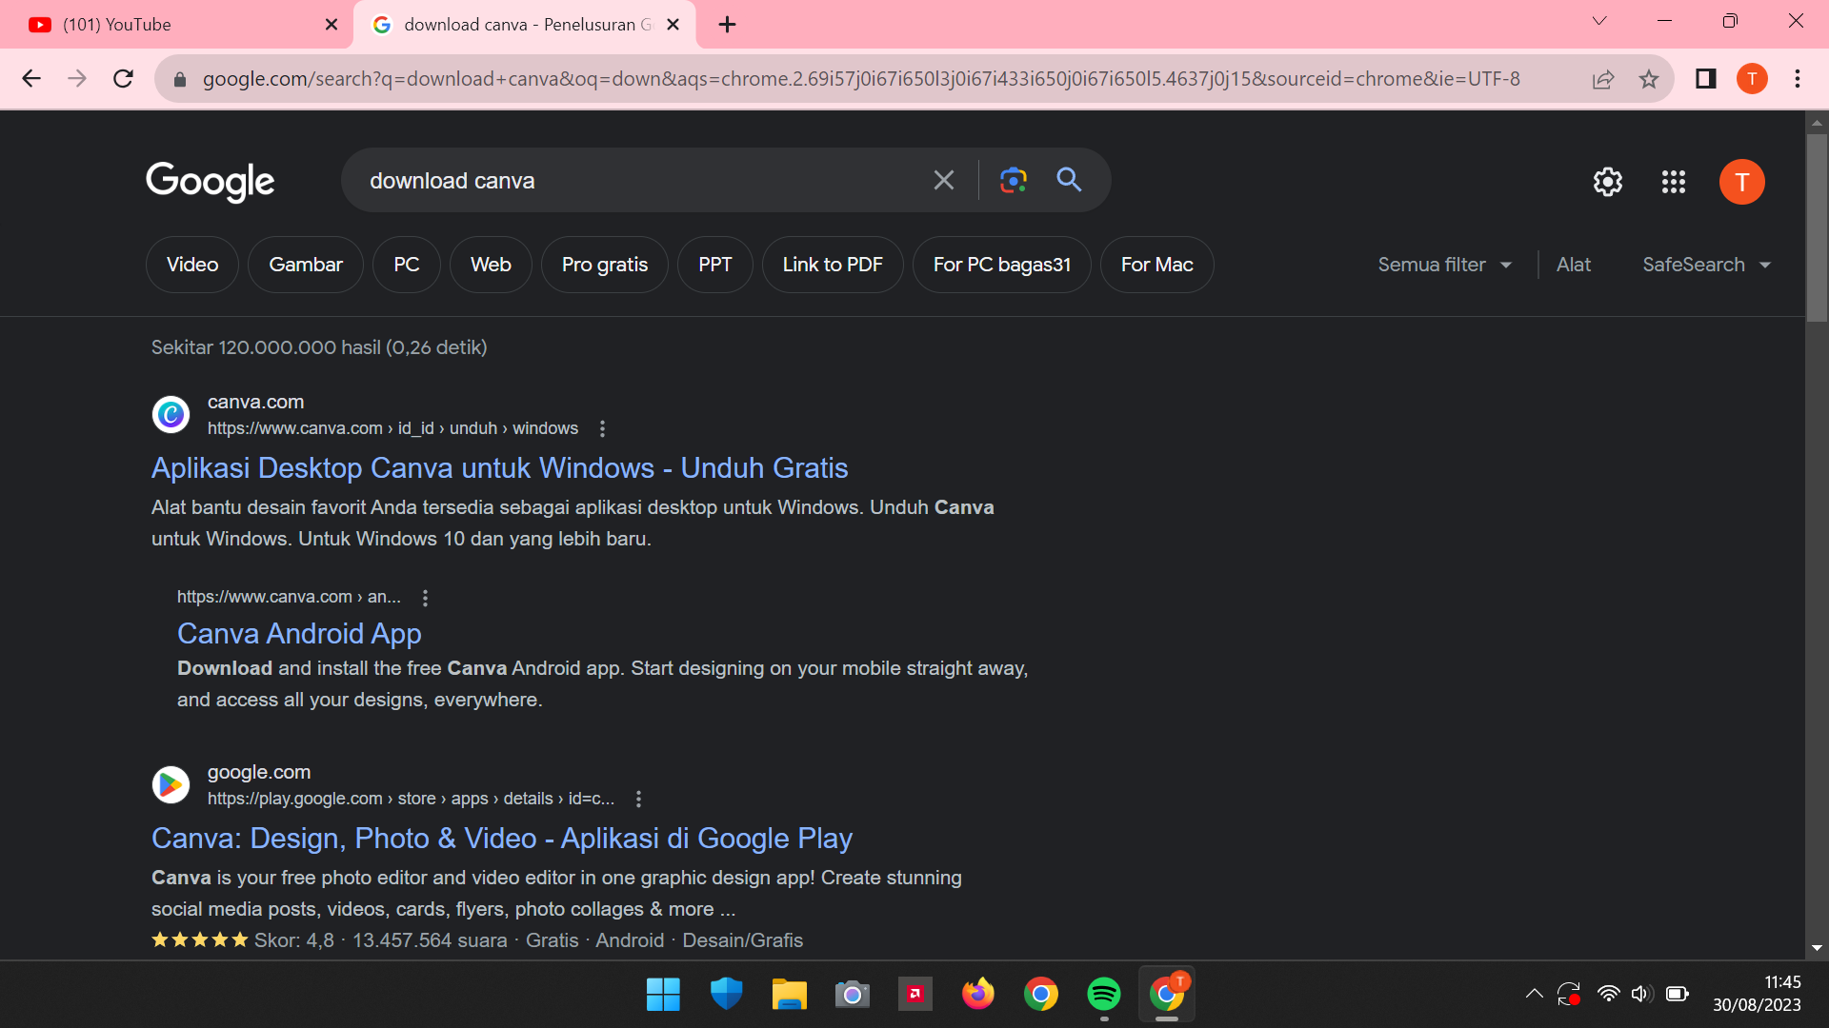
First of all, open a browser or other search engine such as Google or Chrome. Then, search for “Canva download" then click on the website
Source: canva.com

Slide 7
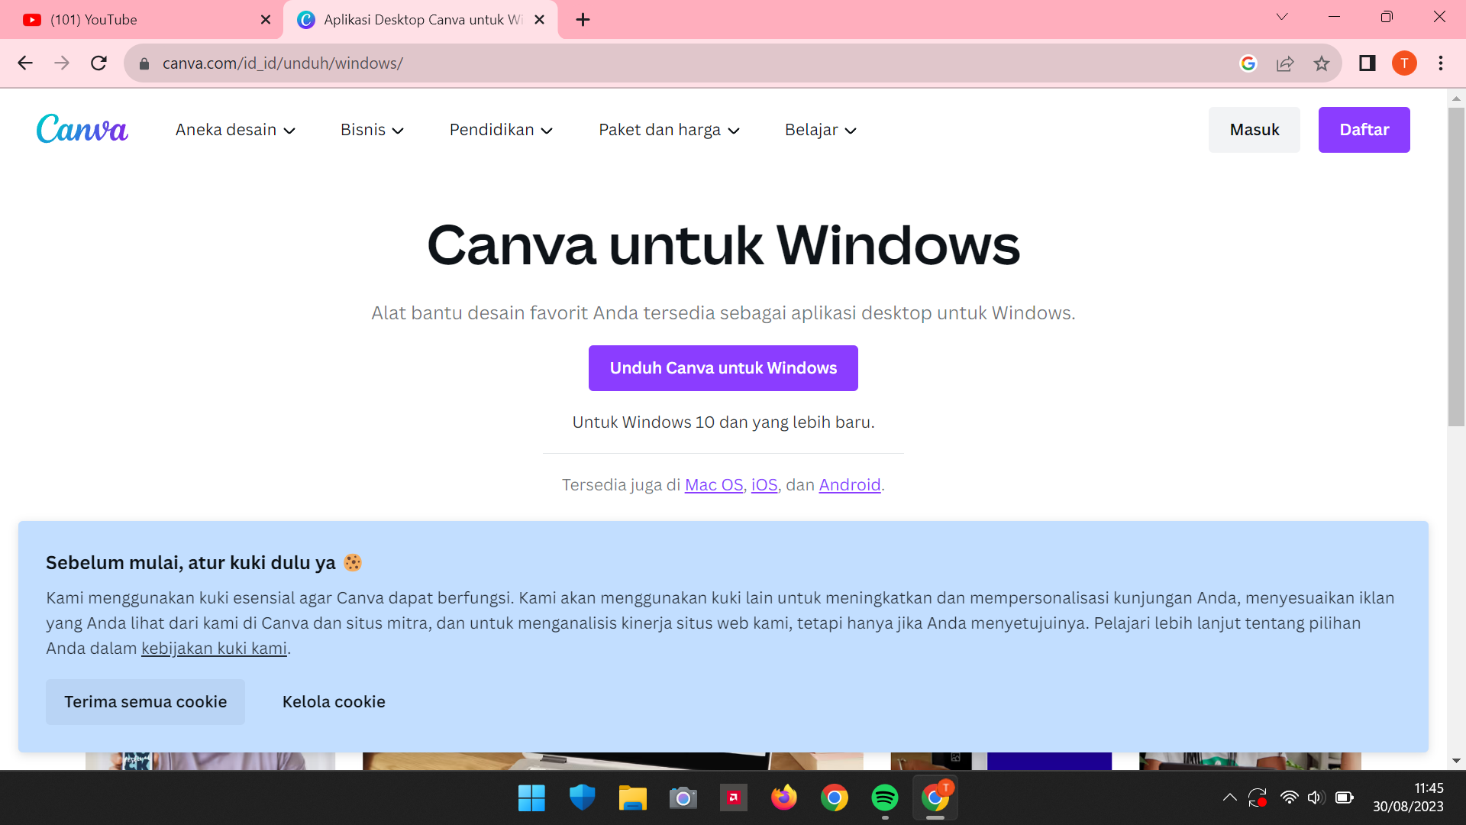
After that, you can immediately see the sentence "download Canva for Windows“. And then, just click on it
Source: https://www.canva.com/id_id/unduh/windows/

Slide 8
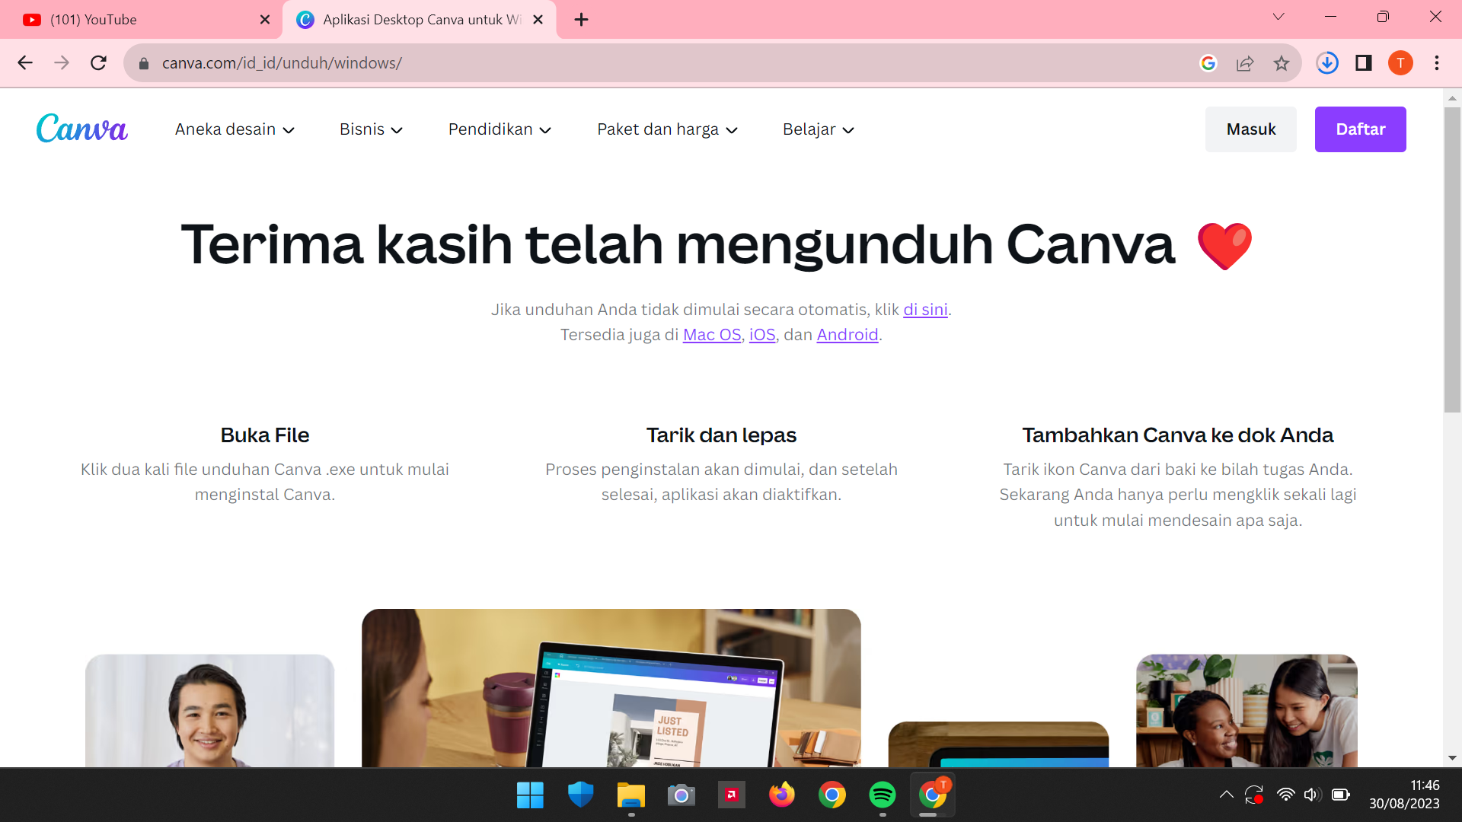
After click, it will say “Thank you for downloading Canva" and your application will enter the download process

Slide 9
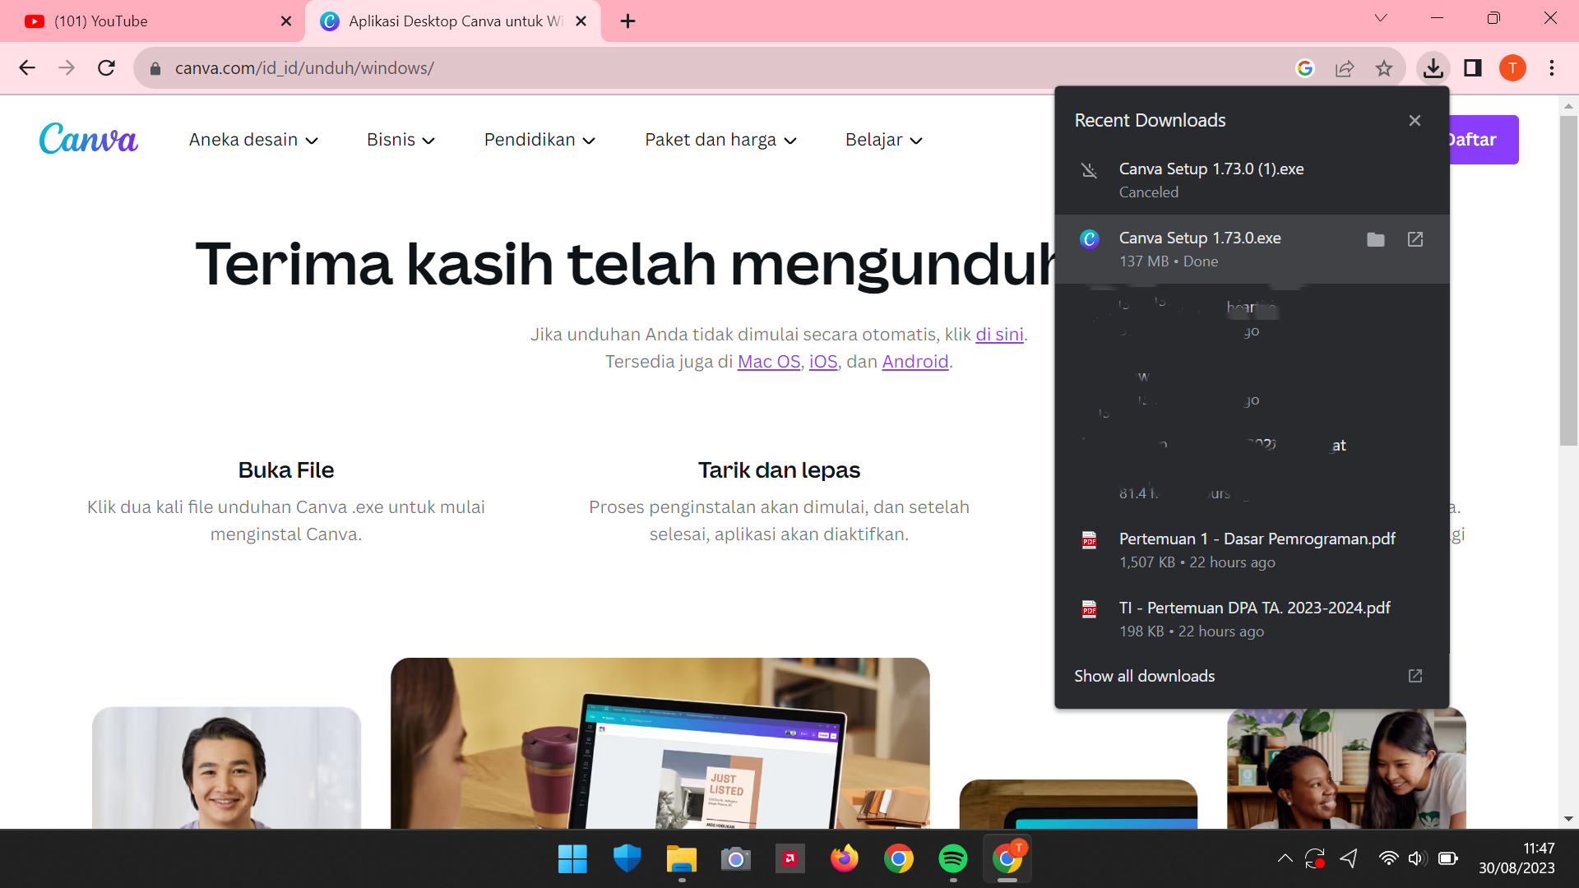
After the download process, your application will appear on the download icon

Slide 10
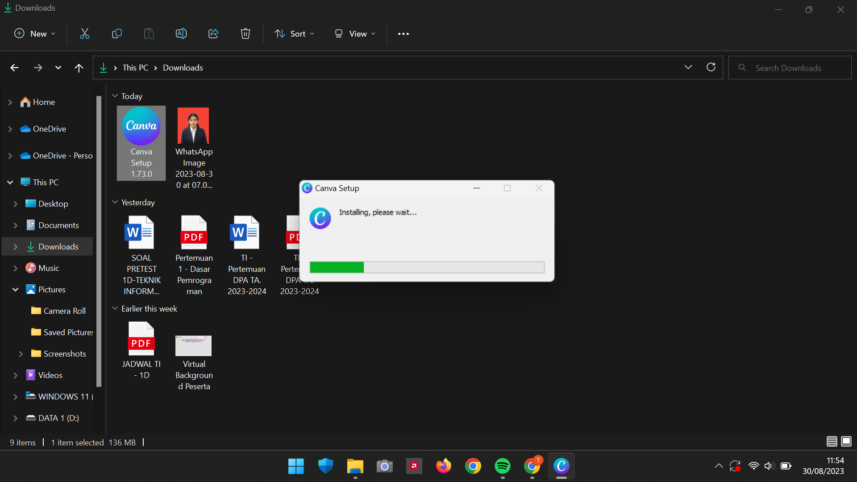
After that, you can open the folder and immediately install or run the application, by double-click on the application file

Slide 11
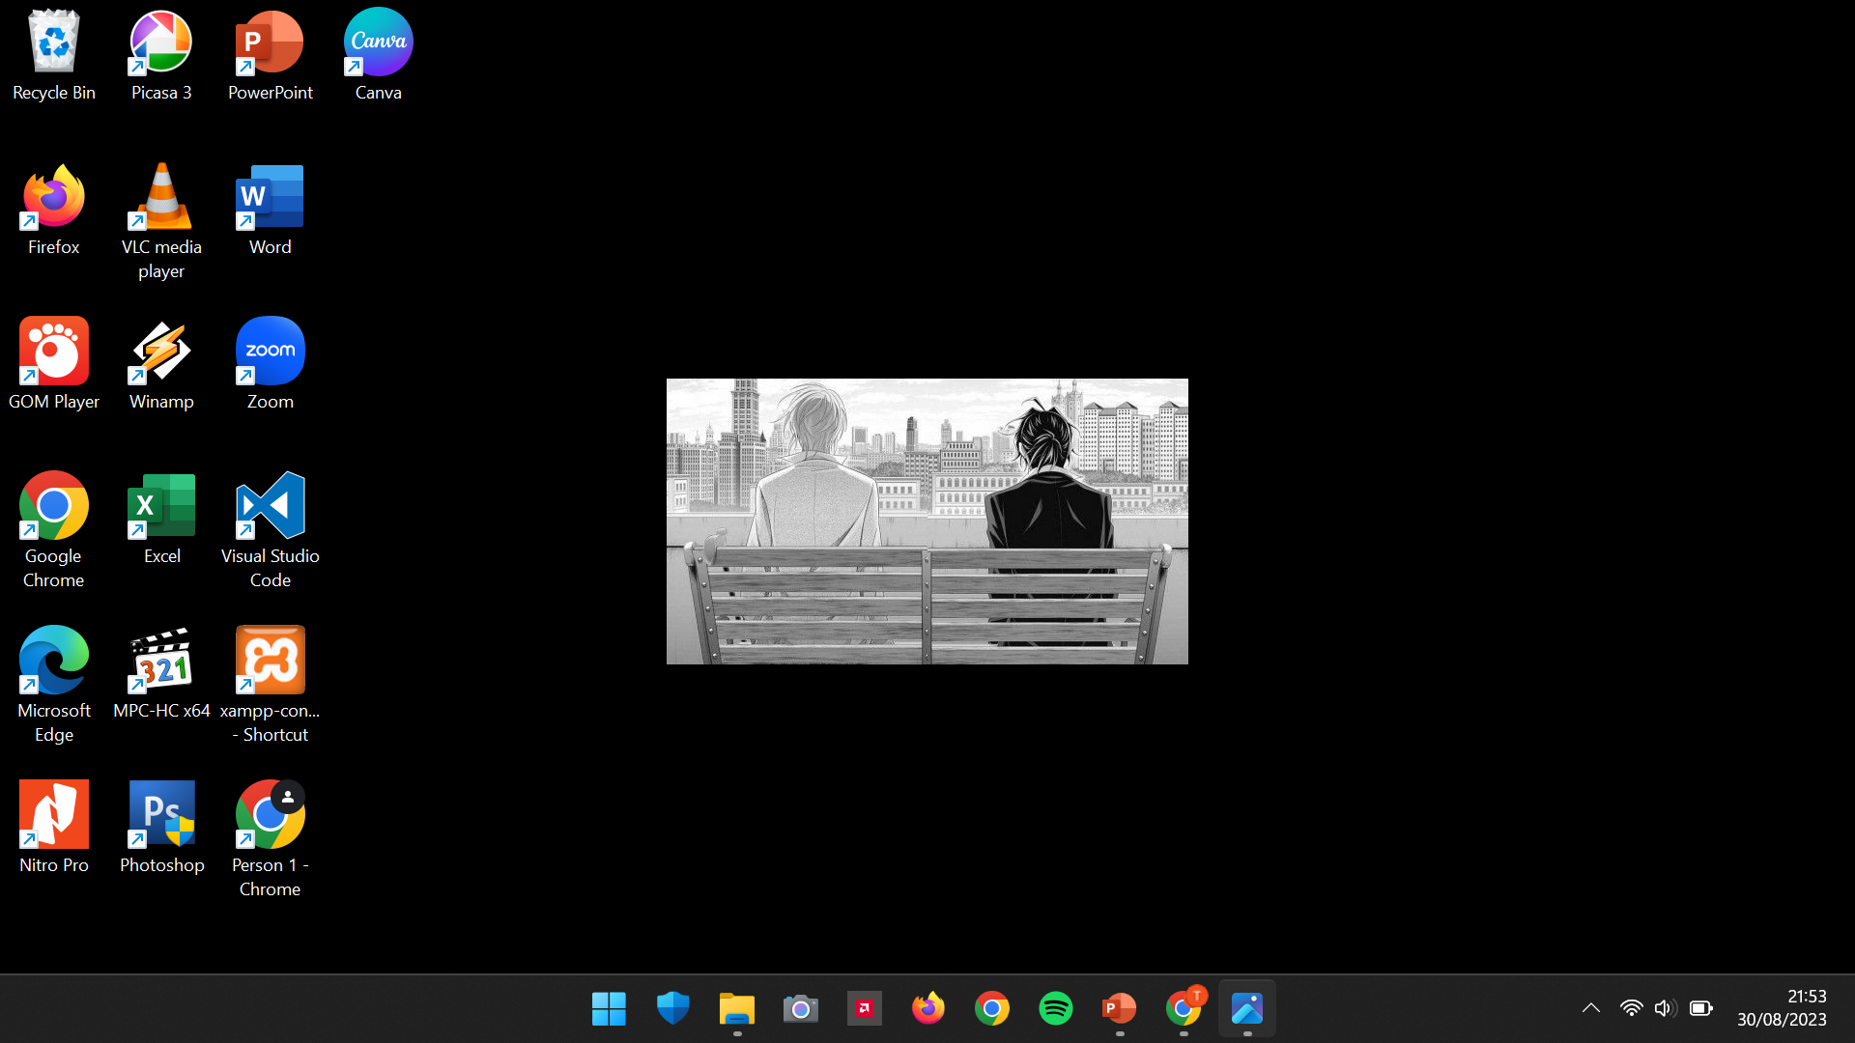
When the download process is complete, the application icon will appear on your desktop

Slide 12
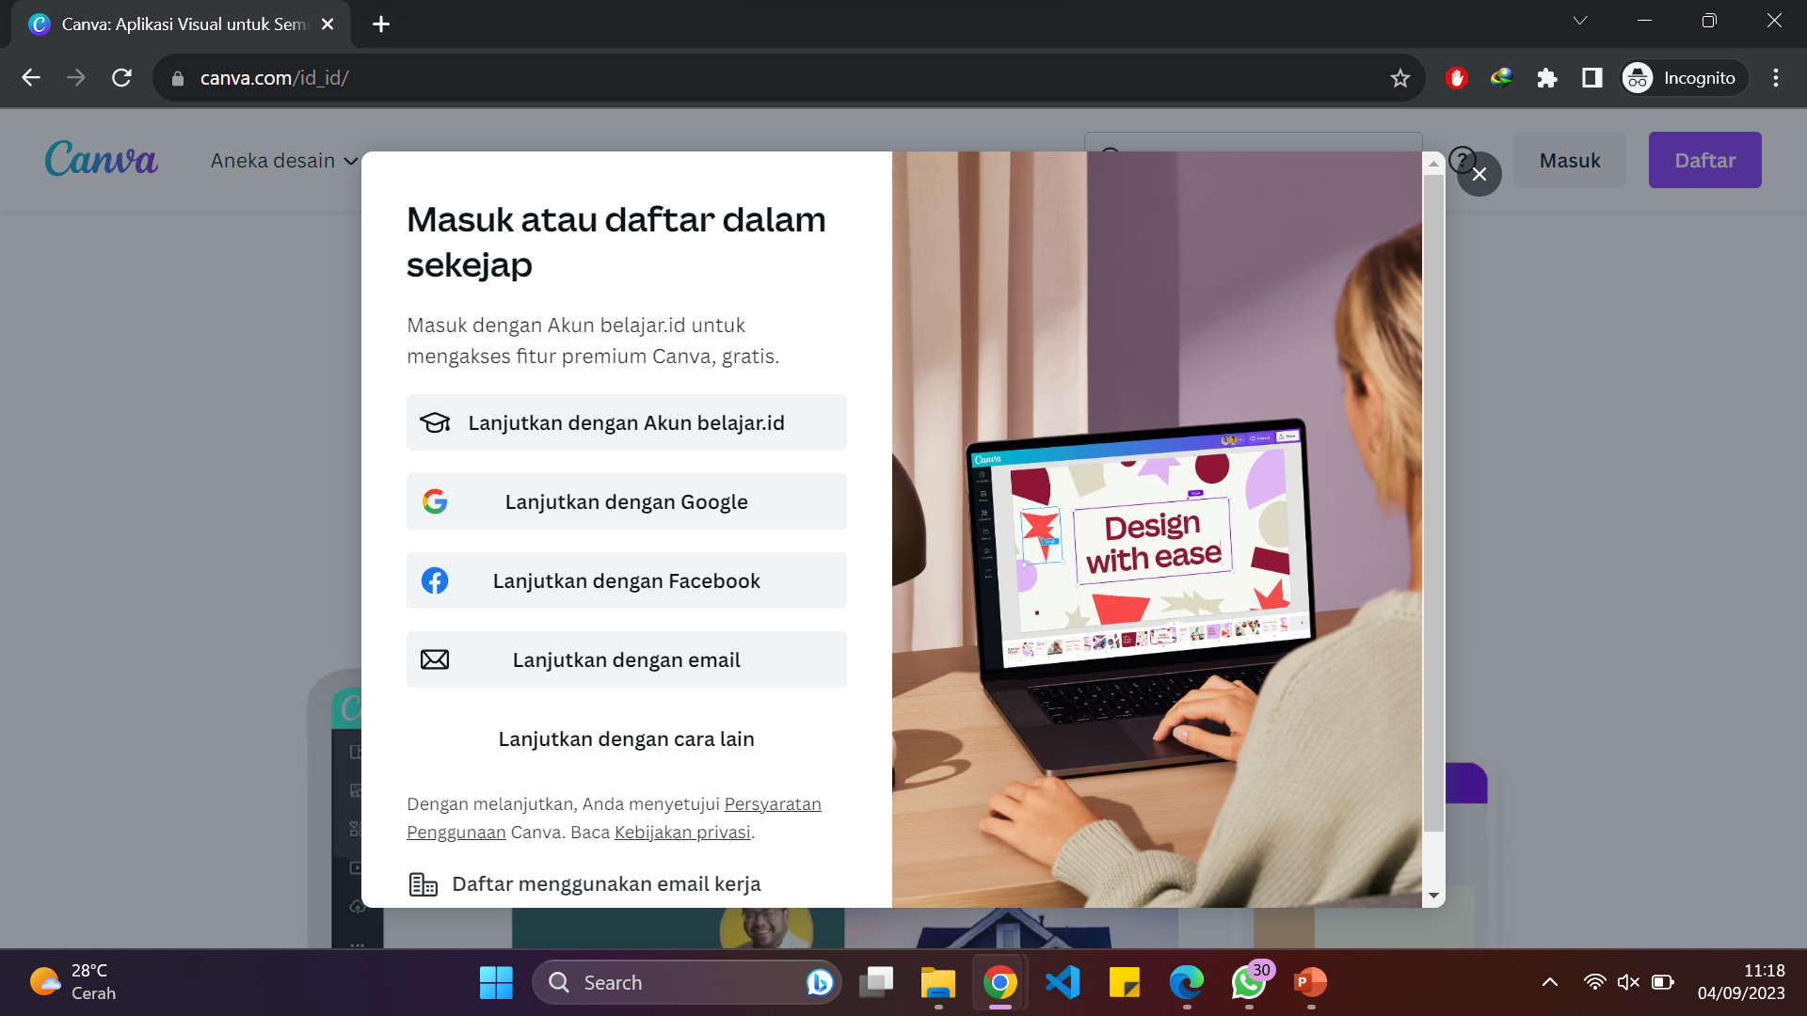
Then, you can click on the application icon. After that, log in or register with a Google account

Slide 13
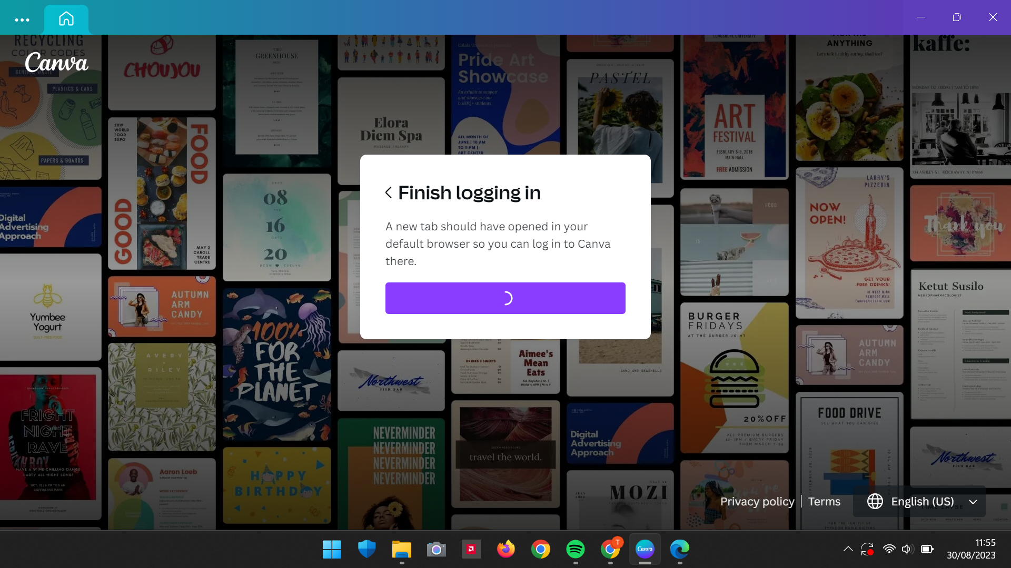
After successfully registering or logging in, there will be a notification like this

Slide 14
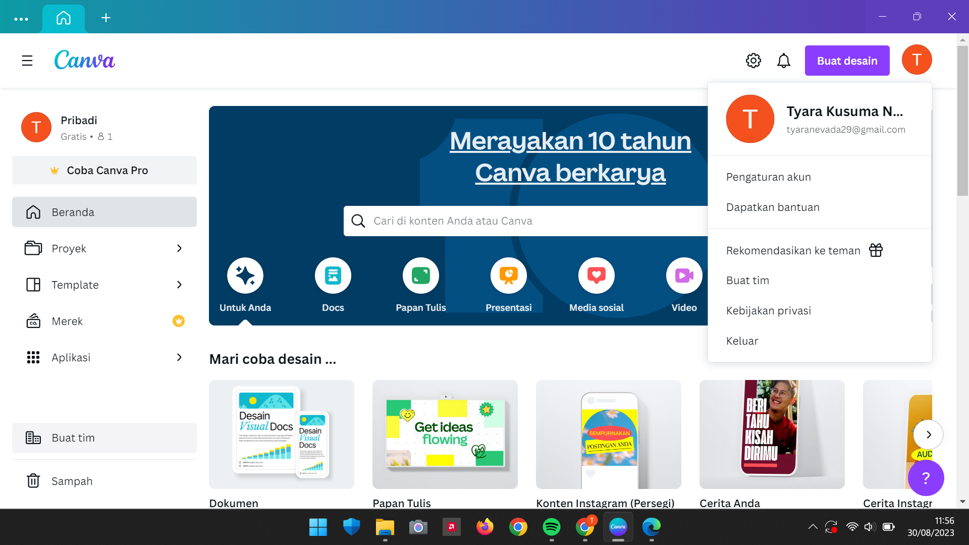
Finished.
Finally, you can use the application according to your requirement

Slide 15
Want to know how to use Canva on Windows?
BAHASA INGGRIS

Slide 16
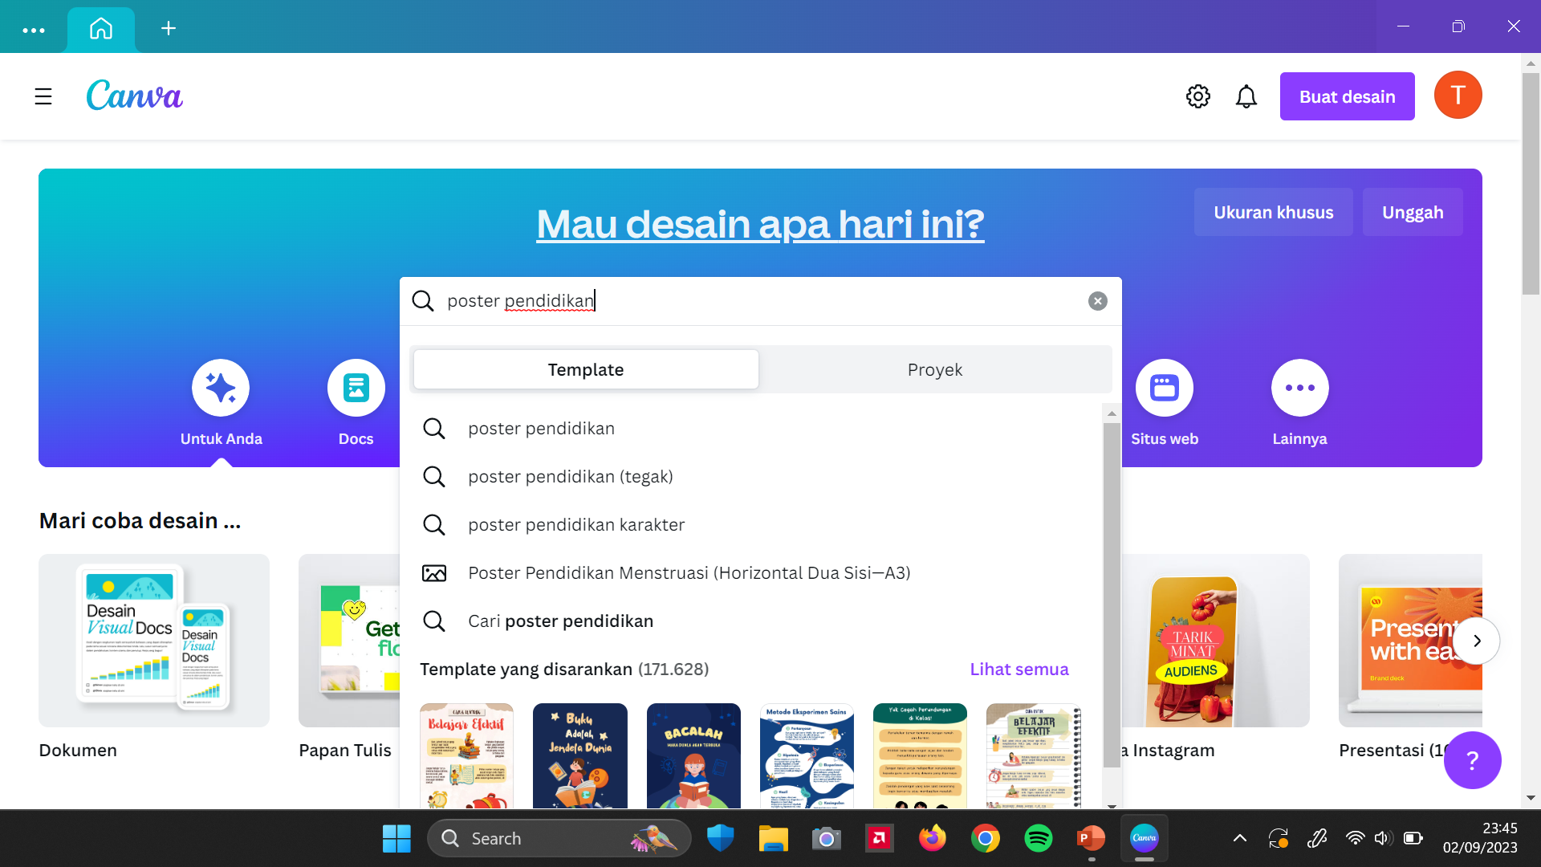
Simple,
you can use Canva by typing your needs in the search bar. For example, if you want to create a poster or PowerPoint design. Like this ☺

Slide 17
How to Install Canva on Android
BAHASA INGGRIS

Slide 18
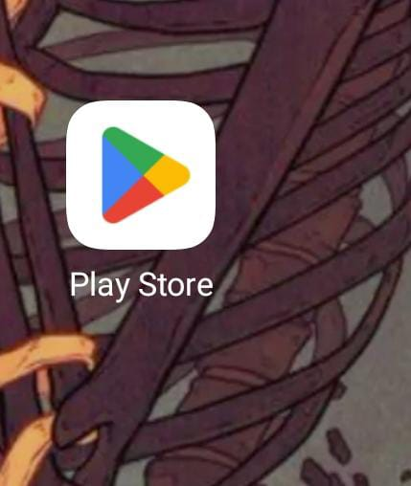
First of all, open the Play Store

Slide 19
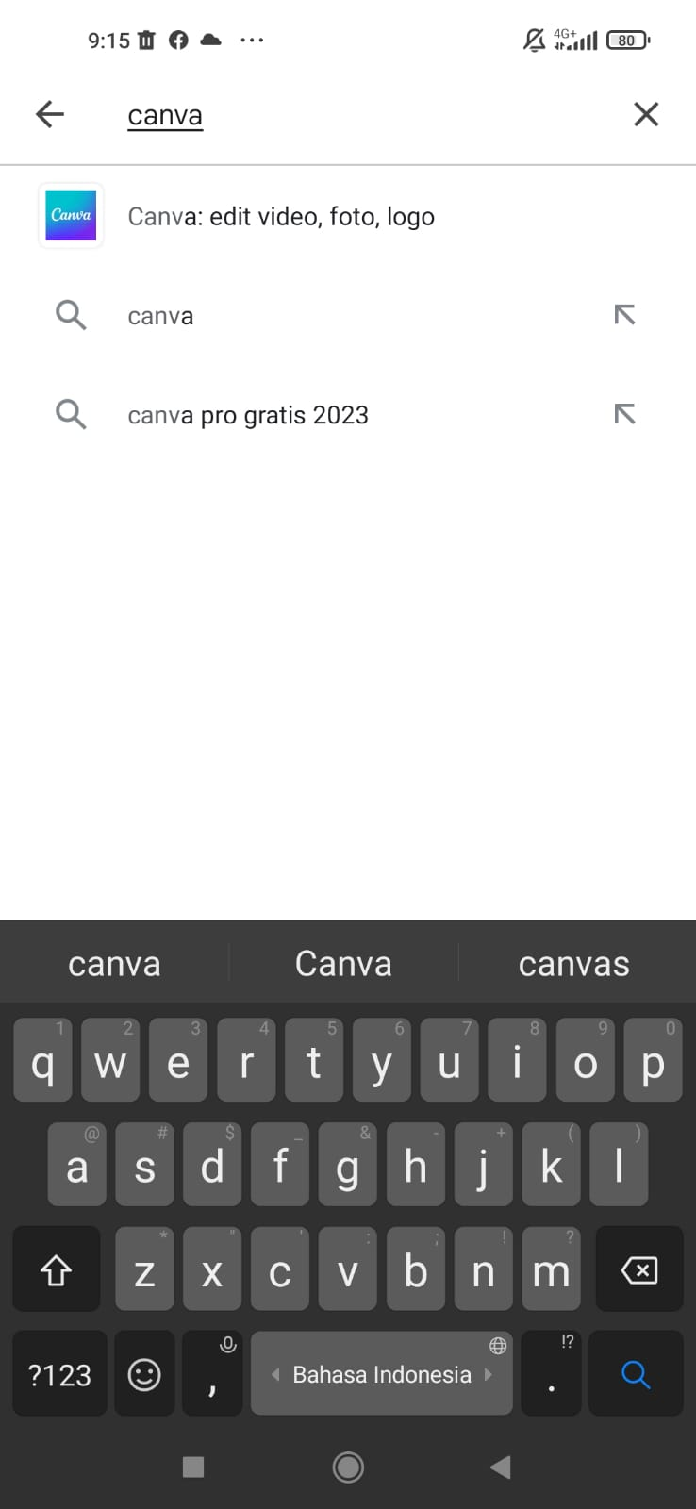
Second, You can search Canva on the search bar

Slide 20
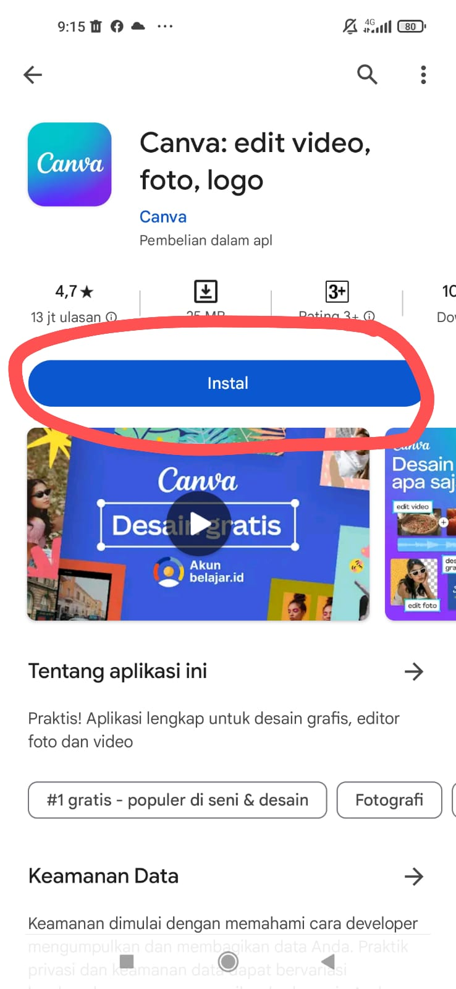
And then, Tap Install

Slide 21
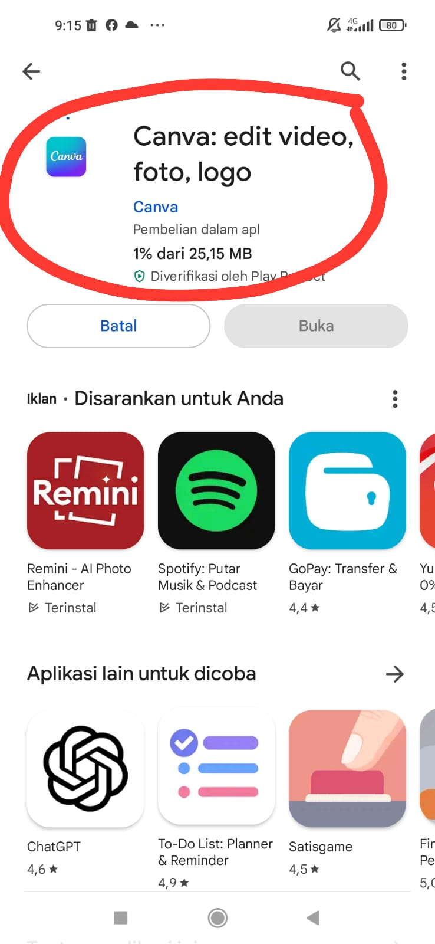
Next, You can wait for the Install

Slide 22
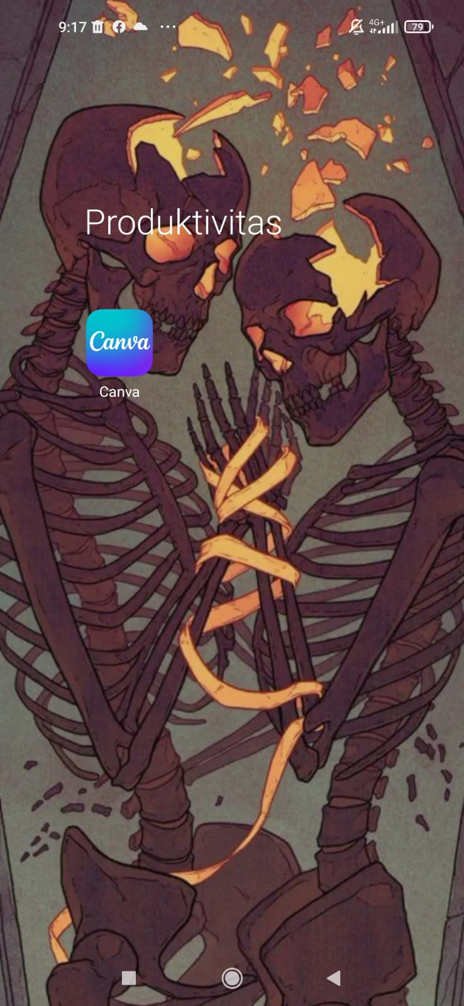
Then, you get the Canva on your Android and tap the icon of the application

Slide 23
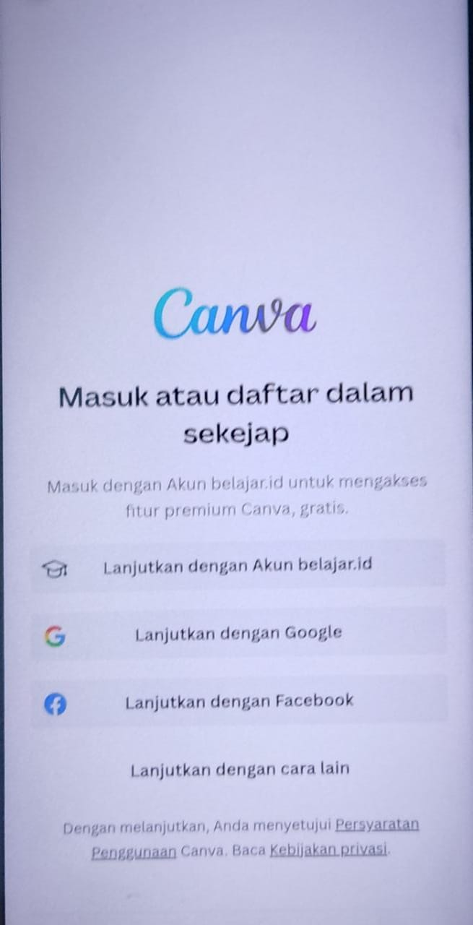
Then, you can log in with several ways

Slide 24
How to use Canva on Android
BAHASA INGGRIS

Slide 25
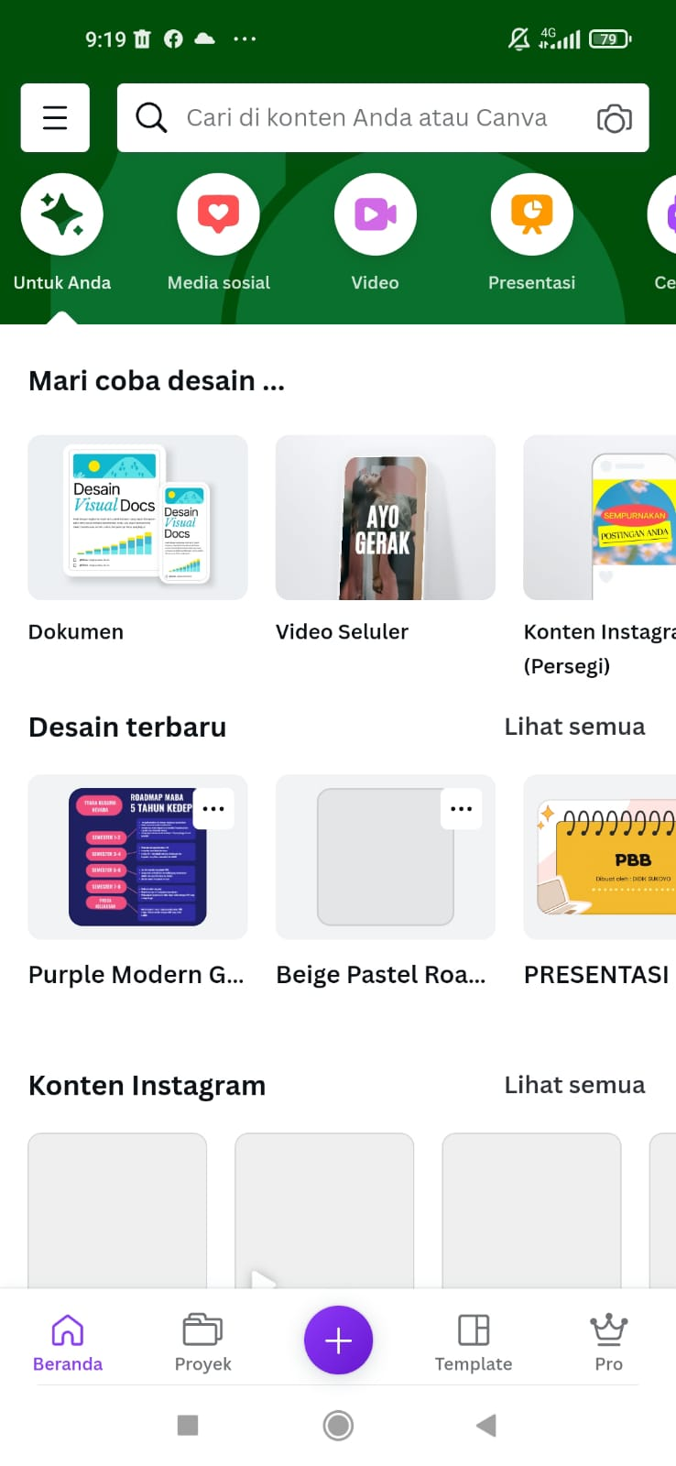
Finally, you can use Canva on your Android, you can use Canva by typing your needs in the search bar. For example, if you want to create a poster or PowerPoint design.

Slide 26
Thank you, that's all. Do you have any questions?
-Group 4 ☺

